Slide 1
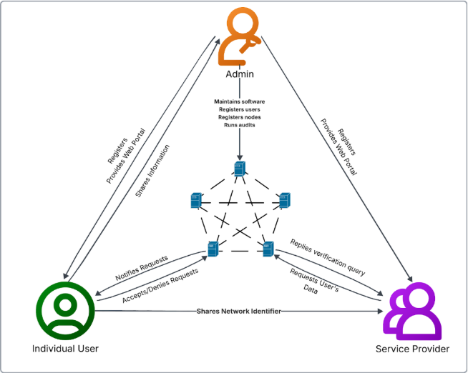
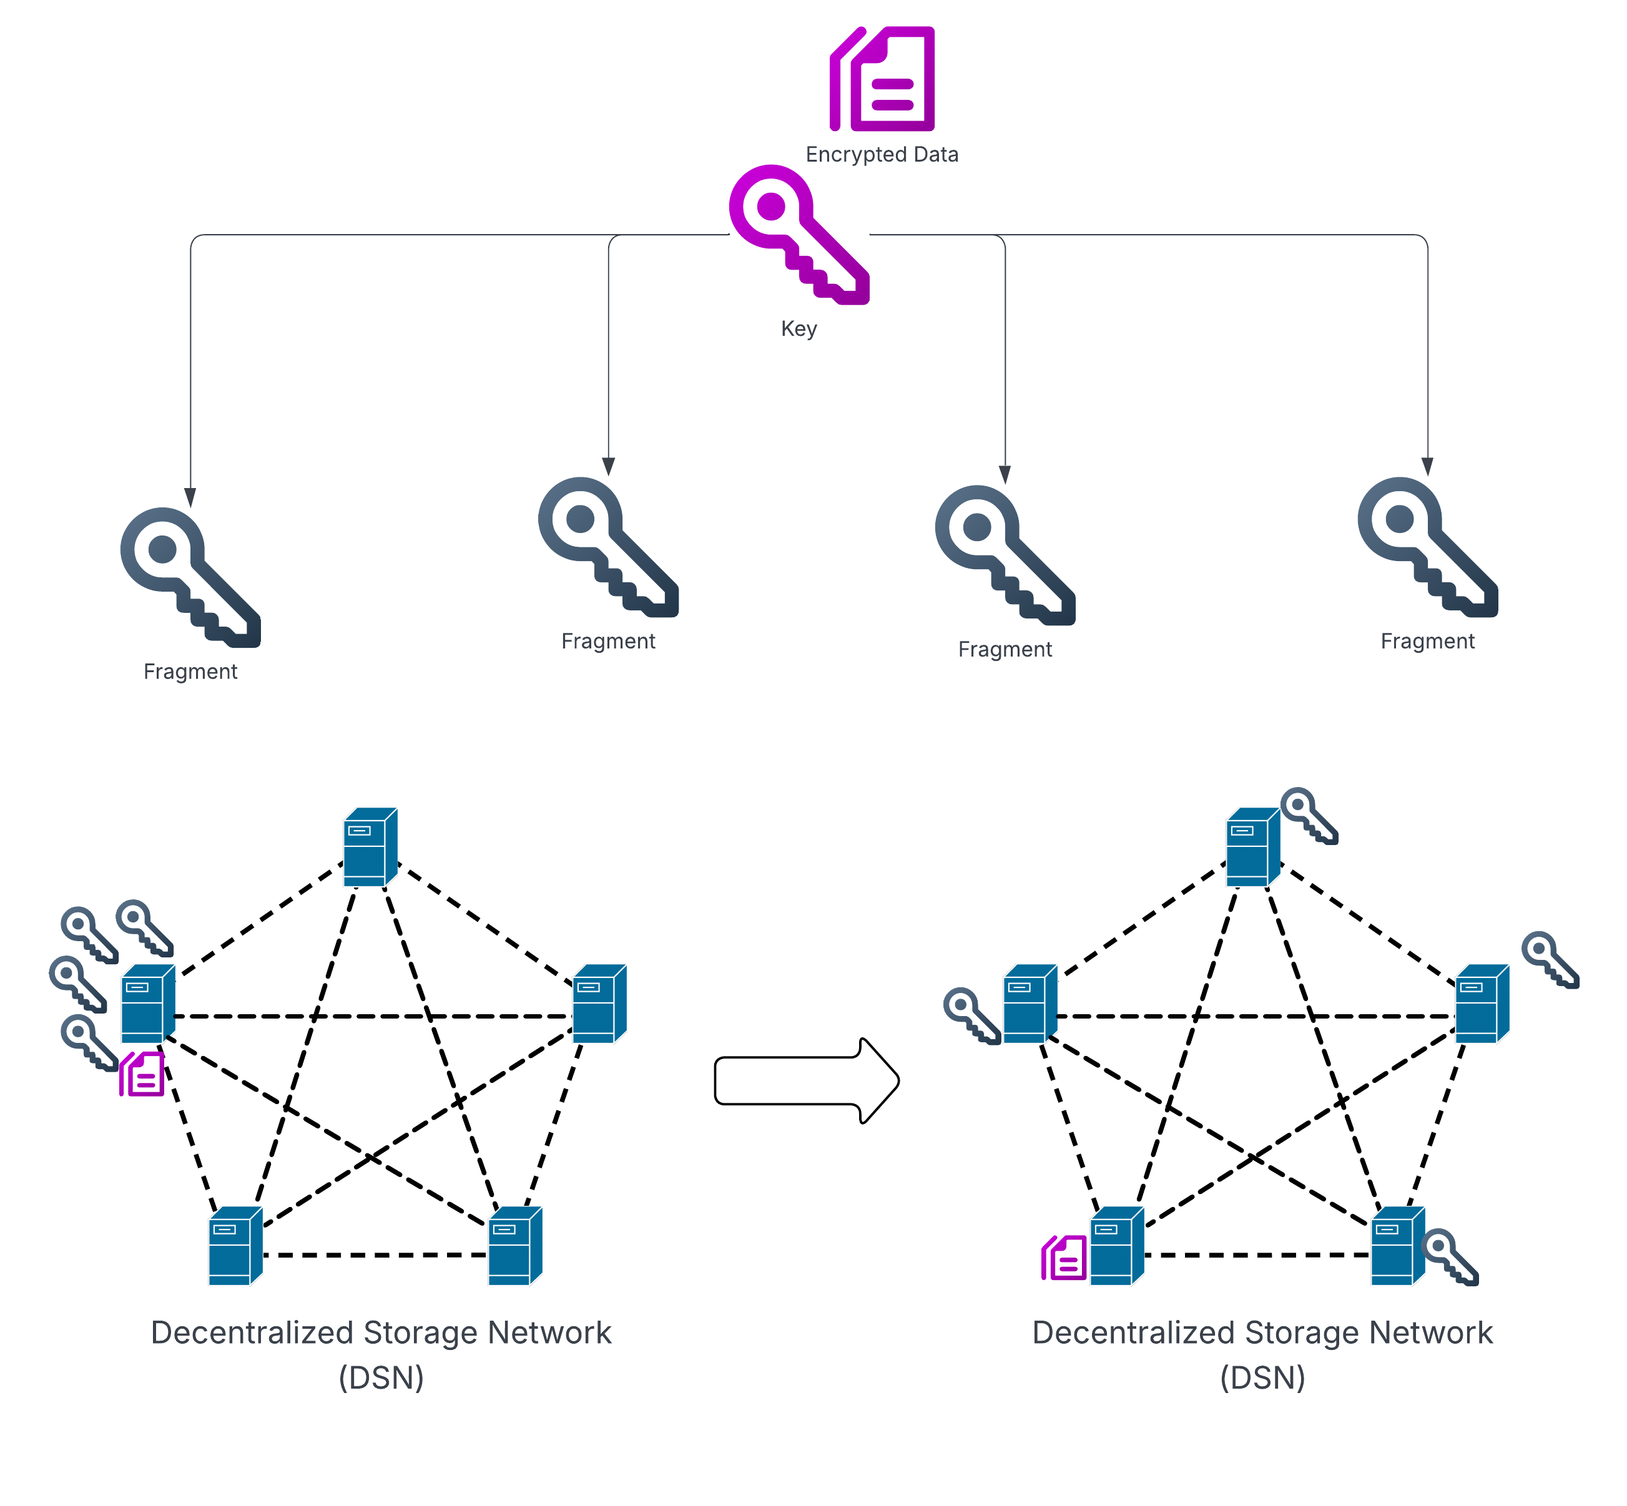
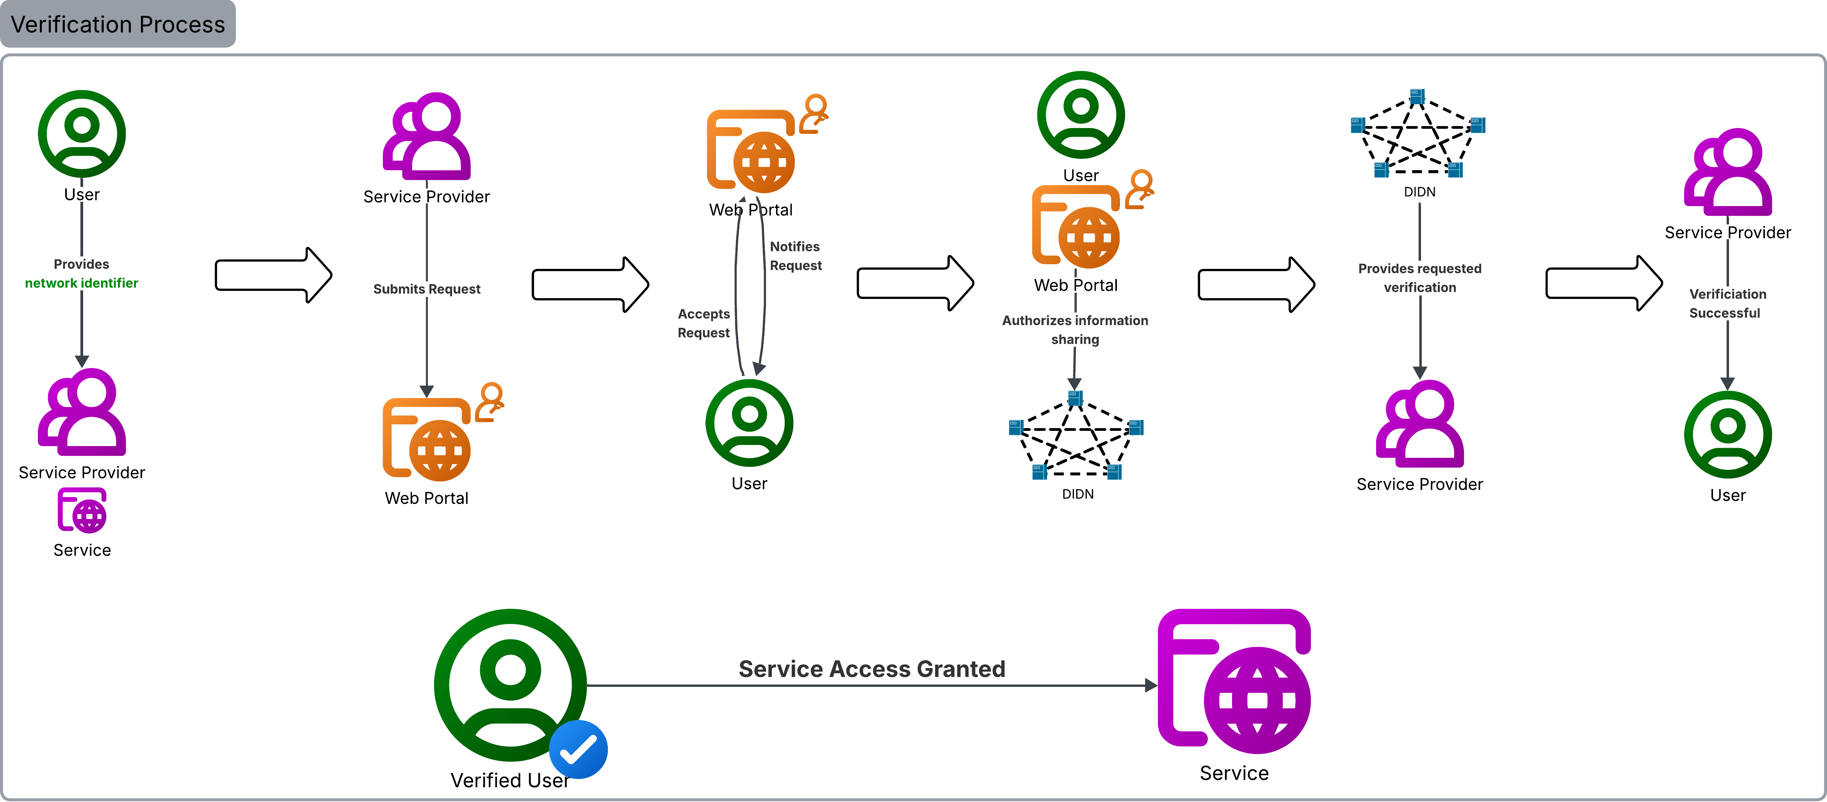
Decentralized Storage Network for Online Verification
Team Members
Faculty Course Facilitator
Santiago Delgado
Kanish Dangol
Syed Shah Bao Nguyen Shiqiang Mo
Dr. KwangSoo Yang
Dr. Zhen Ni
Dr. Waseem Asghar
EGN 4952C
Electrical Engineering & Computer Science
#9
Sponsored by: Mehrdad Nojoumian
Project Advisor
Dr. Waseem Asghar
Problem Statement
Current online identity verification systems rely on either easily bypassed self-reported data or require users to disclose sensitive personal information to centralized databases. This creates significant privacy risks, increases vulnerability to large-scale data breaches, and reduces user trust. The challenge is to design a system that can securely verify identity attributes such as age while minimizing data exposure and eliminating dependence on centralized storage.
Results
This proof-of-concept prototype successfully validated user input and enforced strict data integrity constraints, rejecting incomplete or invalid submissions. Valid user data was transmitted to the decentralized network, where it was encrypted using AES-256 and fragmented across multiple nodes as intended. These results demonstrate that the system reliably performs secure data handling, storage, and distribution within the decentralized architecture.
Conclusions & Impact
With a simple implementation, we have proven there is a real alternative to current online ID verification processes, requiring less human intervention, guaranteeing user privacy protection, and implementing secure cybersecurity practices.

